Slide 1
SALES REPORT OF A PRODUCT-BASED COMPANY
USING MICROSOFT EXCEL

Slide 2
Project Objective
Utilized Microsoft excel to develop a comprehensive sales dashboard that provides clear actionable insights into sales performance.
It involves data cleaning, pivot tables, and various visualizations like sales by category, profit trends, and customer insights.

Slide 3
ABOUT THE DATASET
This is a USA-based product company’s dataset
contains 11 columns and 9994 rows
At first we have to clean the dataset by removing duplicates and blanks.
Also extracted year and month
Added new measurement column such as profit
Finally processed the clean data to retrieve information for decision-making.

Slide 4
RECOMMENDED ANALYSIS
Which sub-category generates most of the sales?
Which category gained the most profit over the years?
Which state has the most sales?
Mention the top 5 customers who contribute most of the profit.
Which category of products has the most count of sales?
Is the monthly trend the same for all the years?

Slide 5
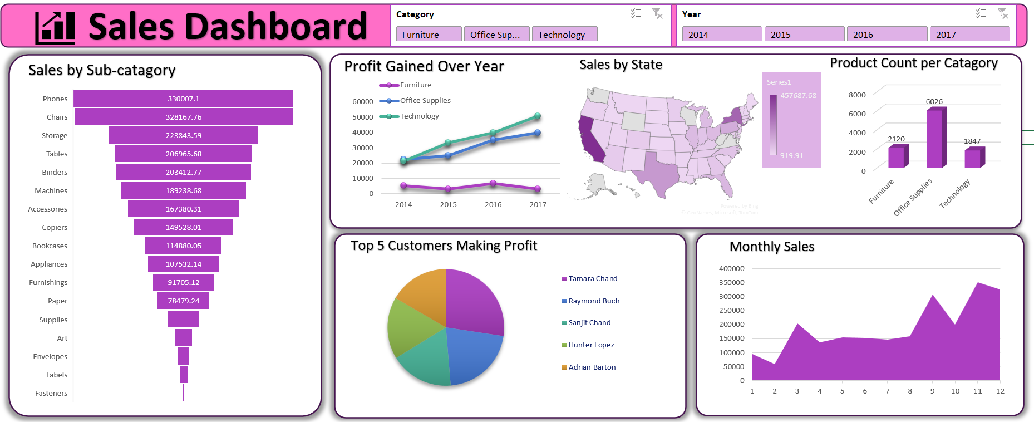

Slide 6

Insights
Sub-category phones generate the most sales
Category Technology gains the most profit over the years
California has the most sales among the states

Slide 7
Insights
Tamara Chand
Raymond Buch
Sanjit Chand
Hunter Lopez
Adrian Barton
Are the top 5 customers
The monthly trend is almost same for all the years from 2014 to 2017
Office Supplies products have the highest demand

Slide 8
THANK YOU

